Slide 1

Commission to Eliminate Child Abuse
and Neglect Fatalities
Notes:
Welcome and introductions:
CECANF speakers include–
Commissioner Patricia Martin, JD, presiding judge of the Child Protection Division of the Circuit Court of Cook County, IL
Sarah Zlotnik, MSW, MPSH, CECANF’s public health advisor
Patricia Brincefield, CECANF's communications director

Slide 2

Commission to Eliminate Child Abuse and Neglect Fatalities (CECANF)
Established by the Protect Our Kids Act of 2012 (P.L. 112-275) to develop a national strategy and recommendations for reducing fatalities resulting from child abuse and neglect.
Notes:
Why was CECANF created? GAO report
What is its goal? To develop a national strategy and recommendations for reducing fatalities resulting from child abuse and neglect (federal, state, etc.)

Slide 3
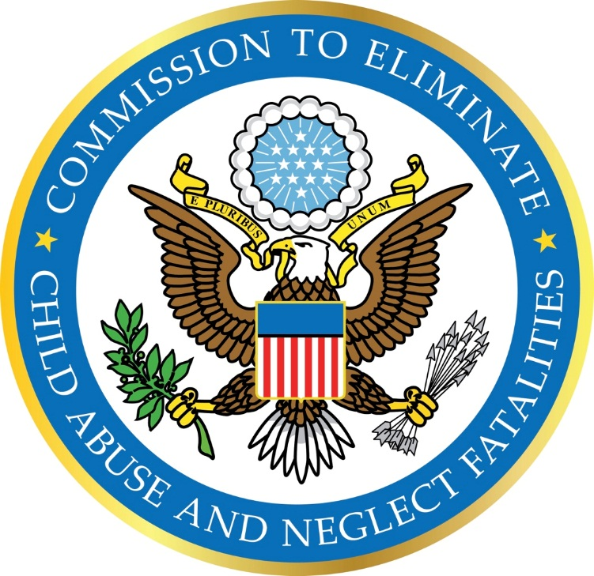
CECANF Is Charged With Studying:
The use of child protective services and child welfare services funded under title IV and subtitle A of title XX of the Social Security Act to reduce fatalities from child abuse and neglect
The effectiveness of the services funded under title IV and subtitle A of title XX
Best practices in preventing child and youth fatalities
Notes:
What is the Commission’s charge?
Commission’s charge and how it is looking beyond CW programs and practices, including:
The use and effectiveness of current federally funded child protective and child welfare services
Best practices for, and barriers to, preventing child abuse and neglect fatalities
Issues such as how confidentiality and data sharing laws, policies, and practices facilitate or inhibit system improvement

Slide 4
CECANF Is Charged With Studying:
The effectiveness of federal, state, and local policies and systems within such services aimed at collecting accurate, uniform data on child fatalities in a coordinated fashion
Barriers to preventing fatalities
Trends in demographic and other risk factors that are predictive of or correlated with child maltreatment
Methods of prioritizing child abuse and neglect prevention for families with the highest need
Methods of improving data collection and utilization
Notes:
The Commission is also charged with studying:
The most and least effective federal, state, and tribal policies and practices impacting the prevention of child abuse and neglect fatalities
What barriers need to be removed to protect children at risk
Trends in demographic and other risk factors that correlate with child abuse and neglect fatalities
How to prioritize prevention services for families with the greatest need
How to improve collection of data on child abuse and neglect fatalities

Slide 5

Commission Members
Dr. David Sanders, Chairman
Executive Vice President, Casey Family Programs
Amy Ayoub
Advocate and presentation skills coach
Marilyn Bruguier Zimmerman
Director, National Native Children’s Trauma Center
Theresa Covington
Director, National Center for the Review and Prevention of Child Deaths
Bud Cramer
Former Member of Congress (D-AL) and founder of the National Children’s Advocacy Center
Susan N. Dreyfus
President and CEO of the Alliance for Strong Families and Communities
Notes:
6 Presidential appointees
6 Congressional appointees

Slide 6
Commission Members
Dr. Wade Horn
Director, Deloitte Consulting, and former Assistant Secretary, Administration for Children
and Families
The Hon. Patricia M. Martin
Presiding Judge, Child Protection Division of the Circuit Court of Cook County, Illinois
Michael R. Petit
Founder and Advisor, Every Child Matters Education Fund
Jennifer Rodriguez
Executive Director, Youth Law Center
Dr. David Rubin
Professor, Perelman School of Medicine at the University of Pennsylvania, and Pediatrician, Co-director, PolicyLab at The Children’s Hospital of Philadelphia
Dr. Cassie Statuto Bevan
Lecturer, Graduate School of Social Policy and Practice, University of Pennsylvania
Notes:
The Commissioners include a former ACF secretary, judge, lawyer, advocates, a former Congressman, a doctor, a state human services/Medicaid director, and others with a broad and diverse range of experience and connection to the issues.

Slide 7
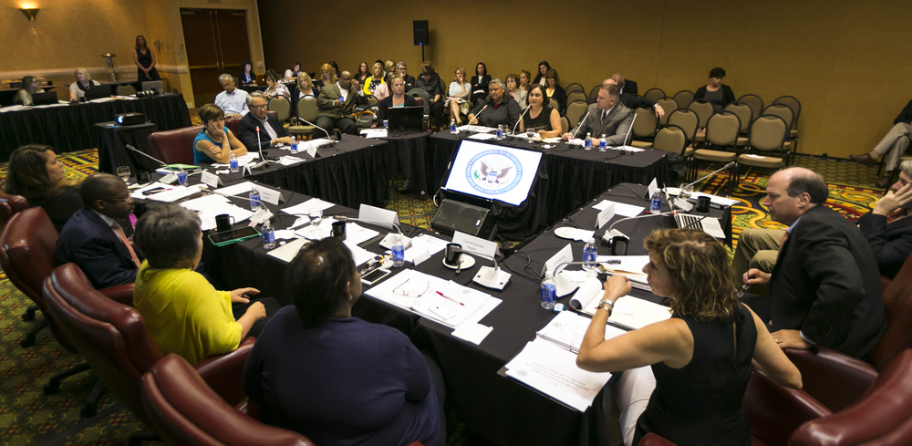
Gathering Information
Through Public Meetings and Events
State public meetings in:
  San Antonio, TX
  Tampa, FL
  Plymouth, MI
  Denver, CO
  Burlington, VT
  Portland, OR
  Memphis, TN
  Salt Lake City, UT
  Madison, WI
  New York, NY
Tribal meeting in Scottsdale, AZ
Research Roundtable in Philadelphia, PA
Ongoing Commissioner deliberations through early December 2015
Notes:
How is the Commission going about its work?
Commission held 10 public meetings around the country and a tribal-focused meeting to learn what’s working, where state and local areas are having challenges, and to learn from the experts
The Commissioners held a research roundtable in Philadelphia
Final deliberations will occur into early December 2015
All meetings are open to the public; information and teleconference number are available on the Events section of the website

Slide 8
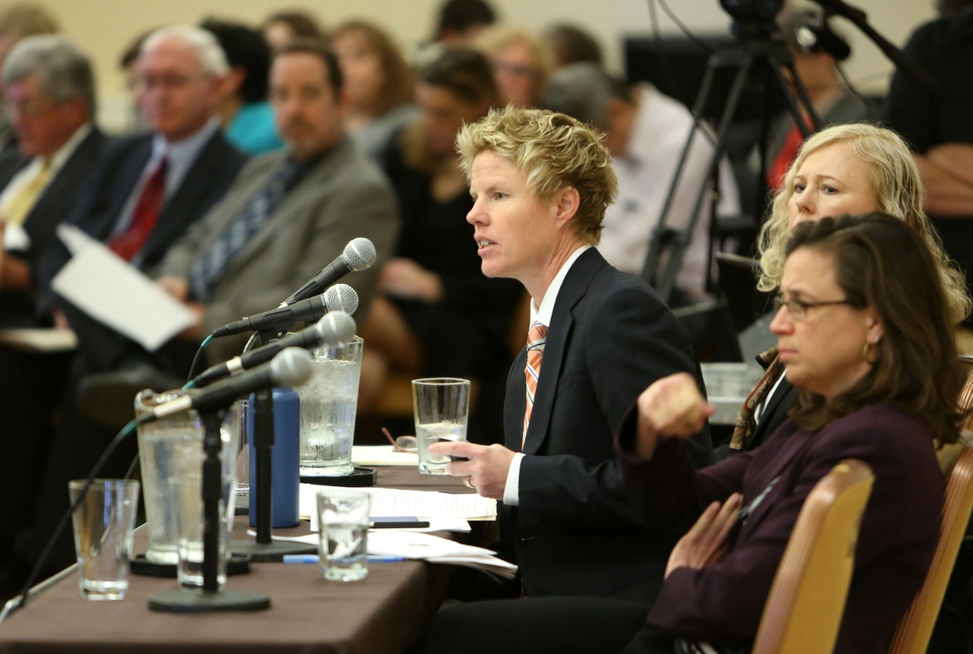
Gathering Information
Through Public Meetings and Events
Federal stakeholder meetings with:
  The White House
  Congress
  Administration for Children and Families
  Centers for Disease Control and Prevention
  HHS’s Assistant Secretary for Planning and Evaluation
  Health Resources and Services Administration
  Department of Defense
  Substance Abuse and Mental Health Services Administration
  Department of Justice
  Centers for Medicare and Medicaid Services
Other stakeholder meetings with numerous local, state, and national organizations
Notes:
The Commissioners are organized into 7 subcommittees – CPS, PH, Disproportionality, Military, NA/AI, Policy, and Measurement.
The Commission is working with federal partners legislatively and administratively to keep them apprised and learn what federal efforts are already underway.
The Commission is also working with local state and national organizations to get feedback and input on solutions.
Public can submit testimony in writing via the website.

Slide 9

How Many Children Died From Abuse or Neglect in 2013?
NCANDS reported an estimated 1,520* children died due to abuse and neglect (4 children every day). This is a rate of 2.04 deaths per 100,000 children in the national population.
In 2011, the Government Accounting Office reported more children likely died from maltreatment than reflected in NCANDS.
Published research suggests the numbers may be 3 times higher than the NCANDS estimate.
*Source: Child Maltreatment 2013
Notes:
What is the scope of the problem the Commission is studying that necessitates a national strategy?
What the data we have shows.
Underestimate: What the data doesn’t show.
Why is a number so important? If we don’t have an accurate way to count the number of children who die, we cannot measure the success or lack of success of interventions designed to decrease fatalities.

Slide 10

Child Maltreatment Fatalities
Happen to Very Young Children
Nearly three-quarters (73.9 percent) of the children who died due to abuse and neglect were younger than 3 years old.
Nearly half (46.5 percent) were under age 1.
Source: Child Maltreatment 2013
Notes:
Our youngest children are at the most risk:
Nearly three-quarters (73.9%) of the children who died due to child abuse and neglect were younger than 3 years old.
Nearly half (46.5%) were under age 1 year.
Infants under 1 -- for every 10 cases of nonfatal hospitalization due to abuse, there was 1 fatal hospitalization.
Deaths among American Indian/Alaska Native and African-American children are overrepresented in child maltreatment fatalities as compared to their proportion in the nation’s child population.
If we know these are the children most at risk, how can we intervene to save them?

Slide 11
Front End—Percentage of Screened-Out Reports
Data source: Child Maltreatment 2013. Data are not available for Hawaii, New York, North Carolina, Pennsylvania, or Puerto Rico.
Notes:
Numbers of screened-out reports are high in most states, and the percentages vary widely.

Slide 12
Child Neglect Is
Involved in a High Number of Fatalities
More than 70 percent (71.4 percent) of child fatalities were attributed to neglect only or a combination of neglect and another maltreatment type.
Nearly half (46.8 percent) of child fatalities were attributed to physical abuse only or to physical abuse in combination with another maltreatment type.
Source: Child Maltreatment 2013
Notes:
Largest percentage is neglect (supervision related – hardest to determine, rollover death, SIDS or maltreatment)
Physical abuse is more prevalent than overall CAN (shaken baby, abusive head trauma).

Slide 13
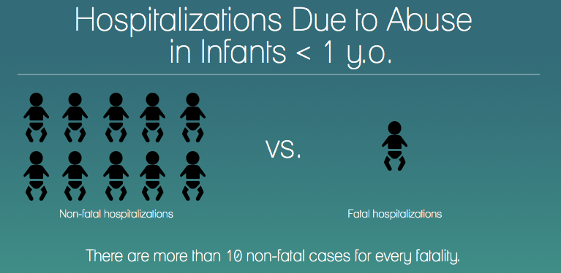
How Common Are Near Fatalities?
Source: Leventhal, J.M., Martin, K.D., & Gaither, J.R. (2012). Using U.S. data to estimate the incidence of serious physical abuse in children. Pediatrics, 129(3), 458-464.
Notes:
For every 10 cases of nonfatal hospitalization due to abuse, there was one fatal hospitalization in infants under one year of age.
Even more children experienced a near fatality.
Near fatalities and fatalities share similar child, perpetrator, and risk factor profiles.
CAPTA: “An act that, as certified by a physician, places the child in serious or critical condition.”
National estimates are not available, and there is wide variation of definitions among states.
However, we have data for nonfatal hospitalization and serious injury in children.

Slide 14
Building a National Strategy
Core Components to Protecting Our Kids
Notes:
The Commission is still BUILDING its national strategy and identifying its core components. The following information reflects our initial observations and recurring themes. What follows does not constitute CECANF’s final recommendations.

Slide 15
Collective Responsibility for Safety
CPS can’t do this alone. A proactive approach to eliminating fatalities requires a safety-focused ecosystem in which child protective services, health care, public health, education, law enforcement, families, and other partners work together toward the common goal of eliminating child abuse and neglect fatalities.
Notes:
Recommendations may include:
State plans to ensure collective responsibility and accountability for preventing fatalities
Dual-generation funding strategies to support families and help to break the intergenerational cycle of abuse
Flexible resources

Slide 16
Leadership and Accountability
Leadership at every level is necessary to:
  Create a sense of urgency
  Sustain attention
  Drive a collective approach
  Shelter this effort from competing priorities
Notes:
Recommendations may include:
Federal leadership across agencies
State plans that include many social service sectors
More effective legislation and policy to support accountability
Attention to government-to-government relationships with tribes as sovereign nations
Public-private partnerships

Slide 17
Stronger Data for Decision-Making
Success will require a stronger knowledge base for developing, testing, and implementing strategies that identify and mitigate risk.
Notes:
Recommendations may include:
Standardized definitions and classification system
More accurate, reliable measurement system
Population-based surveillance system
Improved systems of child death investigation
Adequate data sets and funding availability for necessary research

Slide 18
Implementing Stronger Child Protection Methods
We can apply what we know now to save children’s lives, through more effective identification, assessment, and treatment of children and families at risk by child protection agencies and other key partners (e.g., law enforcement, domestic violence services, behavioral health, medicine, education, and others).
Notes:
Recommendations may include:
An “upstream,” preventive approach
Evidence-based safety assessment methods
Multidisciplinary team investigation and response
Priority responses for children and families at risk
Evidence-based interventions

Slide 19
Developing New Tools and Strategies to Apply What We Know
We must continually expand the cutting edge of our capacity to analyze data and employ resources based on the findings to protect vulnerable children.
Notes:
Recommendations may include:
Predictive analytics
Learning from other industries (health care, aviation, etc.)
Data integration and information sharing across systems
Safety culture

Slide 20

Help Inform the Nation’s Strategy for
Eliminating Child Abuse and Neglect Fatalities
Notes:
QUESTIONS/DISCUSSION

Slide 21
For more information, visit our website:
eliminatechildabusefatalities.sites.usa.gov
Please direct questions and suggestions to
Patricia Brincefield: patricia.brincefield@cecanf.usa.gov

